Slide 1
My Romania Community

Slide 2
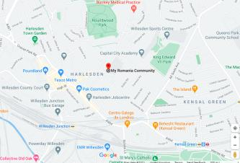
About My Romania Community
Non-Profit Community Organisation
First established in March 2015
Based at Newman Catholic College, Harlesden Road, Willesden, London, NW10 3RN

Slide 3
Aims and Objectives
Community engagement, integration and cohesion
Providing community support and assistance
Promoting culture, language, literature and heritage.

Slide 4
Our Activity

Slide 5
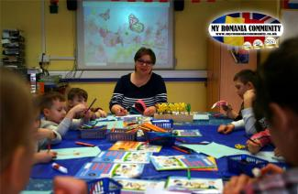
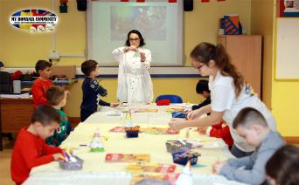
My Romania Community School
Part of My Romania Community
Takes place on Saturday’s, from 10:00am – 1:00pm.
Provides children aged 5 to 14 the opportunity to learn more about Romanian language, literature, culture and heritage in an interactive way.

Slide 6
Community Support and Assistance
Information on accessing services and resources available
Information on current affairs nationally and abroad
Interacting with people finding themselves in unwanted circumstances and providing support to solution needed.
Collaborating with organisations, local authorities and foreign authorities to provide information and support on our social media platforms and face-to-face.

Slide 7
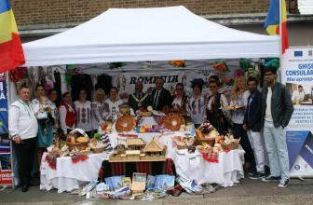
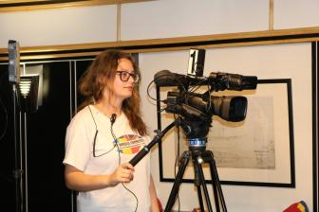
Community Engagement and Culture
Organising and taking part in cultural events face to face and online.
Taking part in organised events for the communities: Love Chalkhill, Harlesden Festival (Summer and Winter Editions), Harvest Festival and more.
Live broadcasted events, concerts, projects, interviews on our social media platforms.
Notes:
Vocea ta, Vocea Comunitatii (Your Voice, The Voice of the Community) – Live broadcasted discussions inviting members of the communities, including authorities. Discussions provided more about the guest and/or current affairs as appropriate.
Carte Pentru Romania (Books for Romania) – An ongoing project since 2016 undertaken to provide educational books and resources to aid children to learn and improve English Language Skills. Resources provided from community members and our project collaborator, Newman Catholic College.
Detached Outreach – An ongoing project series in partnership with Young Brent Foundation, since April 2019, providing information and support to young people in the borough of Brent ages 11-25.
Suete Literare (Literature Gathering) – an online live broadcasted event discussing with writers (books, poetry, script, interpreting) about their life and careers and sharing their work.
Despre Sanatatea Mintala (Discussions About Mental Health and Wellbeing) – A live broadcast project in partnership with Brent Council and Young Brent Foundation, providing information and raising awareness about mental health in Romanian language for young people and their families.

Slide 8
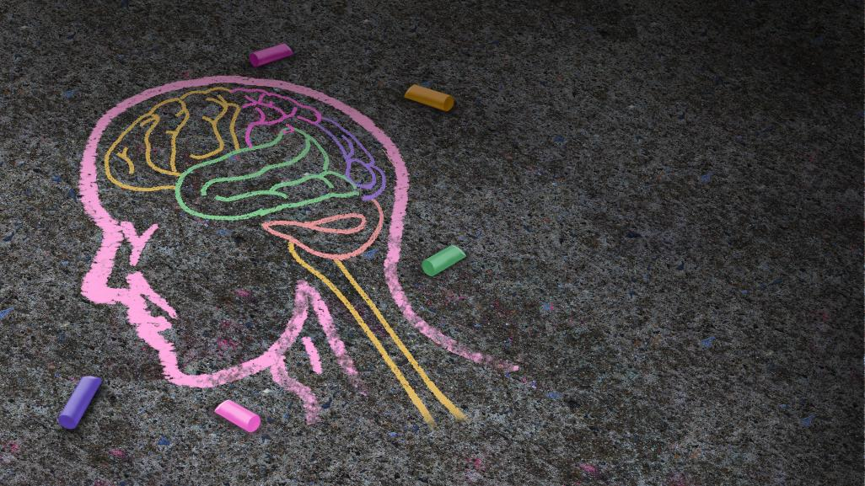
Mental Health and Wellbeing Project

Slide 9
Introduction: DIALOG DESPRE SĂNĂTATEA MINTALĂ
Translation: Discussions About Mental Health.
The project received support from Young Brent Foundation and Brent Council.
The dates had been from 17 December 2020 until 25 May 2021, for the duration of 5 sessions.
The sessions had been live broadcasted on our Facebook platform, and shared on our other platforms.
People could call in and ask any questions they had.
This Photo by Unknown Author is licensed under CC BY-SA

Slide 10
Objectives
Provide information to young people and their families about mental health and wellbeing.
Raise awareness and combat stigmas around mental health and wellbeing.
Start and encourage conversations around mental health especially considering COVID-19 and effects this has had on young people and families.
Provide the information for unlimited time – allowing young people and their families to access the live broadcast as it takes place and after.

Slide 11
Reaching Out to the Community

Slide 12
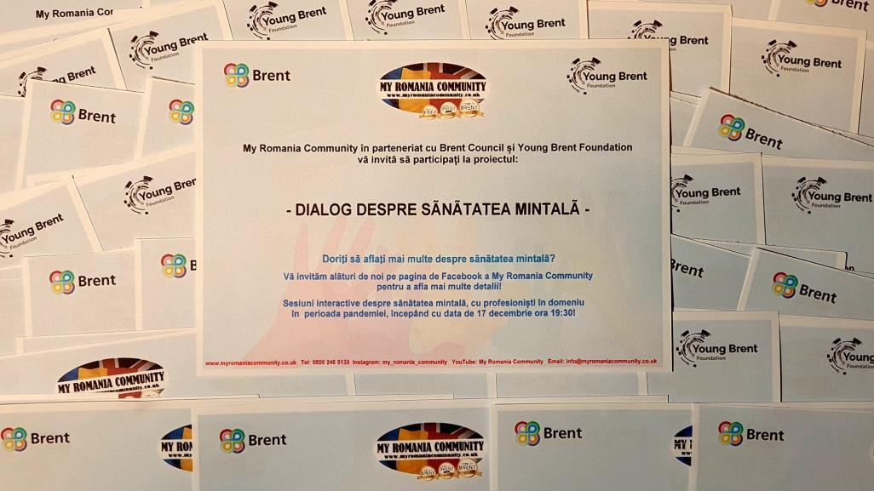
Notes:
As part of the project, in engaging members of the community we have compiled flyers to be shared across our platforms and during session of detached outreach (which had been restriction dependent and limited), in ensuring we engage with as many young people and their families as possible, in providing the remote support and information about mental health and wellbeing and its importance.

Slide 13
Notes:
These are the virtual posters that had been shared, on vast groups and platforms to attract more young people and their families.

Slide 14
The Sessions

Slide 15
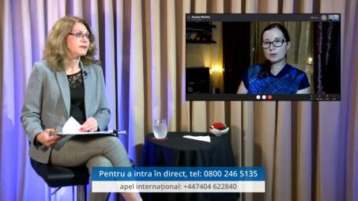
Live Broadcast 1 – About Mental Health and Wellbeing
Introducing the series of 5 live broadcasted sessions
Introducing concepts of mental health and wellbeing
Defining mental health and wellbeing
Discussing importance of mental health and wellbeing

Slide 16
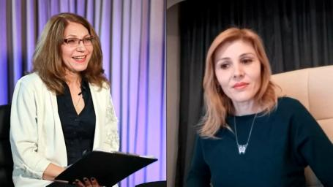
Live Broadcast 2 - About Stress
Introducing the concepts of stress
Discussing the signs of someone experiencing stress
Discussing factors that can contribute for one to experience stress (including but not limited to: school, work, pandemic, caring responsibilities)
Discussing the pandemic and stress
Discussing how stress can have an impact in day-to-day situations.
Discussing how we can overcome feelings of stress and maintain positive mental health and wellbeing.

Slide 17
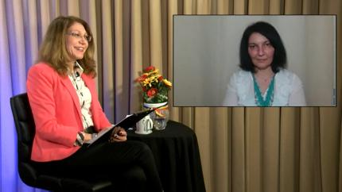
Live Broadcast 3 – About Worrying
Introducing the concepts of worrying and concerns.
Introducing and discussing some of the main factors contributing to worrying.
Discussing the pandemic and the impact this had on worry.
Discussing strategies of overcoming feelings of worry and uncertainty and maintain positive mental health and wellbeing.

Slide 18
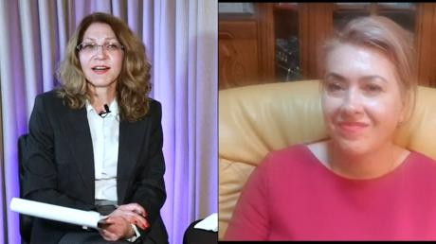
Live Broadcast 4 – About Addiction/Dependency
Introducing and defining the concepts of addiction.
Discussing vast possibilities of addiction/dependency.
Discussing the pivotal points when addiction/dependency can start having an impact on day-to-day situations.
Discussing strategies of living with, seeking help, managing addiction/dependency, and maintain positive mental health and wellbeing.

Slide 19
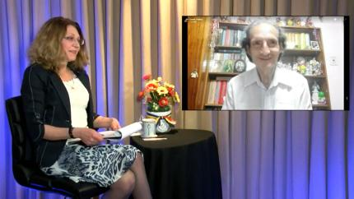
Live Broadcast 5 – Mental Health and Wellbeing and the Pandemic
Conceptualising the pandemic and discussing the impact on mental health and wellbeing.
Discussing strategies that have been useful in maintaining positive mental health and wellbeing.
Providing information on resources and organisations available in London Borough of Brent for young people and families to access for further guidance, support, and possible treatment programmes.

Slide 20
Outcomes

Slide 21
Number of people reached:
Overall total = 18,104
Overall total (Male) = 7,059
Overall total (Female) = 11,005
Overall accounts belonging to young people = 978*
*This is according to algorithm. Young people may have accounts with an older registered age. Some may also watch it from a parent account.
Signposting to other services:
Young people and their families who viewed the live broadcasting have been signposted and encouraged to access their GP and other resources available in the Borough of Brent: Young Minds, Brent Young People Thrive, Brent Centre for Young People, Kooth, Brent Child and Adolescent Mental Health Services (CAMHS), Twining Enterprise, Crisis Skylight Brent and Rethink Mental Illness, as found on Brent Youth Zone and Young Brent Foundation websites.
Achievements:
Young people and families have more resources.
Increased awareness about Mental Health.
Increased confidence in accessing services available
Increased self-help resources in managing mental health during the pandemic

Slide 22
Hopes for the Future…
Notes:
More opportunities to expand the mental health project

Slide 23
Social Media and Contact Details
For more information, collaboration proposals and referrals please kindly find us on:
Tel: 0800 246 5135
Email: info@myromaniacommunity.co.uk
Web: www.myromaniacommunity.co.uk
Facebook: My Romania Community
YouTube: My Romania Community
Instagram: My Romania Community
Twitter: @Rou_Community

Slide 24
Thank You!

