Slide 1
National Child Measurement Programme (NCMP) Data Review
16 December 2020
Notes:
This is the big reveal of the 5+1 ways to wellbeing
Ask what they think are the evidenced based lifestyle things that are proven to increase resilience and mental wellbeing (it is interesting to note that sleep and nutrition issues are not specifically in the list, but have some validity, so acknowledging them but moving on is important)
The five reveal on clicks (with a hyper link to the New Economics Foundation findings and research report) and a cheeky 6th has been added about creativity (the evidence for which comes later)
Ask if it all makes sense? And that the following slides will explore each of the 5+1 further.

Slide 2
NCMP Introduction
The National Child Measurement Programme (NCMP) is a nationally mandated public health programme.
NCMP is a key part of the government’s approach to tackling child obesity.
Public Health England provides strategic leadership and support for this programme, and local authorities deliver it.
https://www.gov.uk/government/collections/national-child-measurement-programme
NCMP measures the height and weight of over one-million children aged 4-5 and 10-11 years each year in primary schools in England
The NCMP dataset also includes deprivation data

Slide 3
NCMP Data
The Data
2 key data sets under review in this study
NCMP 2017/18 = 7327 rows
NCMP 2018/19 = 7336 rows
NCMP 2019/20 = 7160 rows
Data for Borough of Brent only
Key fields Included in NCMP data:
  Gender
  Ethnicity summary
  Ethnicity detail
  BMI score
  BMI code
  School data
  School ward data
Method & Analysis
Using SPSS software, this is statistical analysis software which is especially useful for running the correlation elements of the project.
Interim presentation to focus on BMI, School data and Ward data.

Slide 4
Objectives
Key Objectives:
Review BMI trends over the period
Ensure detail by ward is included
Ensure that school detail is included in order to understand where resources need to be allocated.
Sections in Presentation
Categorical Data
BMI Data
Conclusions
Appendix

Slide 5
Categorical Data

Slide 6
NCMP Gender
Relatively even split between males and females in the sample.
Gender is an important categorical variable when considering BMI data.
2019/20 gender data has same % split as previous year.

Slide 7
NCMP Ethnicity Summary
Ethnicity summary
Data quality issue as the ‘not stated’ in 2018/19 is large (16.1% of population) versus only 3.2% in the previous year. This dropped to 10% in 2019/20, but remains high.
This figure has not been adjusted as NCMP is official data and also any adjustment could equally be open to criticism.

Slide 8
NCMP Ethnicity Detail
Ethnicity detail
The ‘not stated’ causes similar issues relating to comparison despite improvement
The schools to potentially contact to improve data collection are listed in appendix 1
The top 10 schools listed in appendix 1 account for 68% of this ‘not stated’ segment
It is recommended that a data improvement initiative is implemented. Perhaps as simple as writing to each school.

Slide 9
NCMP Reception & Year 6
% split between reception and year 6
This is an important categorical characteristic when considering BMI
Gradual increase in year 6 percentage over the 3 year period

Slide 10
BMI Data

Slide 11
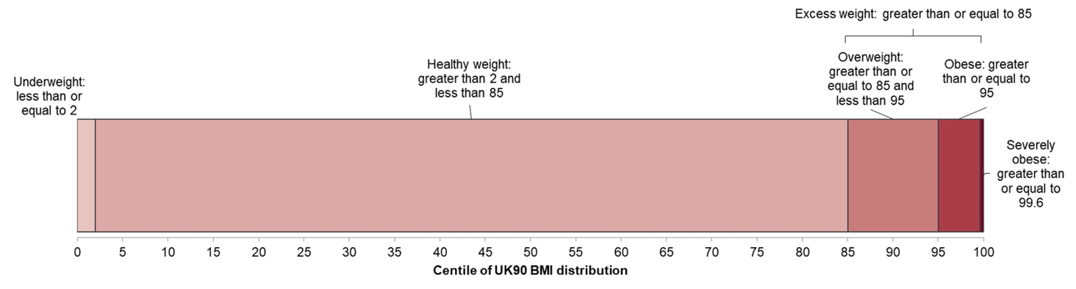
BMI Definitions
BMI is classified according to the following image using the British 1990 growth reference (UK90)
The NCMP data set follows the classification
The term ‘very overweight’ is used rather than obese in the NCMP data

Slide 12
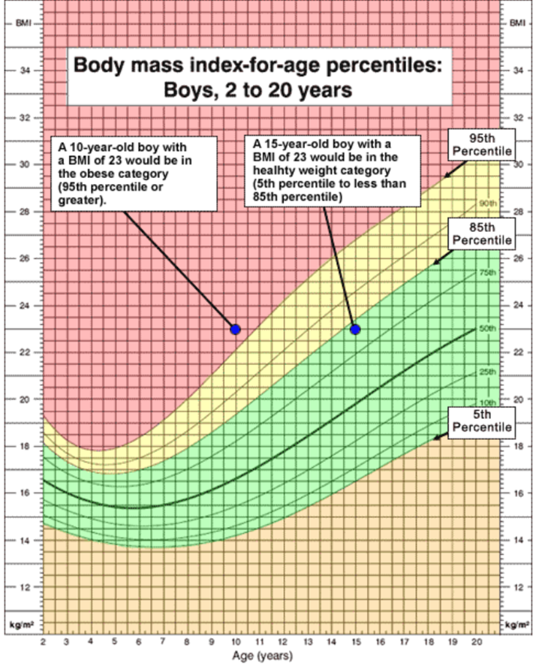
Body Mass Index Reference Curves for the UK, 1990 (Cole, Freeman & Preece)
BMI of children is more complex than for adults
Children’s BMI changes as they mature and growth patterns differ between boys and girls.
Therefore both the age and gender of a child need to be taken into account when estimating whether BMI is too high or too low.
These thresholds are derived from a reference population, known as a child growth reference. They are calculated by weighing and measuring a large sample of children to identify how BMI varies by age and sex across the population.
The UK90 BMI reference provides centile curves for BMI for British children from birth to 23 years. This is based on a sample of 32,222 measurements from 12 distinct surveys collected between 1978 and 1994.
The UK90 shows the pattern of growth and also provides an average BMI for a boy or girl at a particular age, and the distribution of measurements above and below this value. This means that individual children can be compared to the reference population and the degree of variation from an expected value can be calculated.

Slide 13
Brent BMI Classification – 31% Overweight or Very Overweight, Improvement Continues !
The improvements seen in 2018/19 continue into 2019/20
Increase in healthy weight by 2.7% to 66.5%
Overweight % continues to fall to 12.7% in 2019/20 (1.6% decline versus previous year).
Similarly the very overweight (obese) % fall to 18.3%
In 2019/20 there were 31% in the overweight and very overweight categories (against 33.8% in 2018/19)
The initiatives in place are working

Slide 14
Brent BMI Classification – 2.2k Pupils Overweight or Very Overweight – But Improvement
1287 pupils very overweight (obese) and 889 overweight = 2176 in 2019/20 combined
Improvement on previous years
2453 in 2018/19, so absolute numbers have reduced by 277 pupils in 12 month period.

Slide 15
% Overweight & Very Overweight Increases In The Year 6 Cohort
By school year there is a large increase in ‘very over weight’ in year 6 compared to reception year (graph illustrates point).
The over weight and very overweight averages have declined progressively from 36.8 in 2017/18 to 33.8% in 2018/19 and down to 31% in 2019/20
There are 37 schools where BMI is greater than the 31% average (2019/20) for the overweight and very overweight categories (these are graphed on slide 20)
The full listing (all 63 schools) is included in appendix 2, also see appendix 3.

Slide 16
Brent Medium Term Trend Upward – But Improvements In Last 2 Years
Trend lines starting to flatten, especially overweight & obese
More prevalence of obesity in yr 6 than reception (quite pronounced)
Similar trend when review overweight & obese
Source : LG Inform Data

Slide 17
Overweight & Very Overweight By Brent Ward - 12 Wards Above The Average
 | 2017/18 % Overweight & Very Overweight | 2018/19 % Overweight & Very Overweight | 2019/20 % Overweight & Very Overweight
Stonebridge | 48.9 | 37.8 | 37.1
Harlesden | 46.7 | 44.7 | 35.8
Fryent | 27.1 | 34.2 | 35.2
Dollis Hill | 46.8 | 36.8 | 34.4
Sudbury | 33.2 | 27.9 | 34
Welsh Harp | 38.1 | 35.2 | 33.9
Willesden Green | 40 | 41.7 | 33.8
Dudden Hill | 45.8 | 45.2 | 33.7
Kilburn | 49.1 | 41.9 | 33.5
Tokyngton | 31.7 | 35.6 | 33.2
Queensbury | 34.3 | 29.3 | 32.6
Kensal Green | 52.3 | 44.2 | 31.7
Preston | 29.5 | 33.5 | 30.8
Wembley Central | 32.1 | 31 | 30.2
Barnhill | 32.4 | 26.3 | 29.5
Mapesbury | 38.1 | 36.2 | 29.3
Kenton | 22.1 | 27 | 25
Queens Park | 36.8 | 30.9 | 24.7
Northwick Park | 26.2 | 26.2 | 24.6
Brondesbury Park | 39.1 | 24.9 | 19.8
Alperton | 20.9 | 18.1 | 19.1
Total | 36.8 | 33.8 | 31
Pink = > average BMI
In 2019/20 there were 12 wards that exceeded the average
The worst ward was Stonebridge

Slide 18
Severely Obese By Ward 2019/20
% of severely obese by ward
Average is represented by the purple line, at 4.5% in 2019/20
14 wards equal to or greater than the 4.5% average
Tokyngton had the most prevalence of severe obesity at 7.1%
Also see appendix 7 for progression by year

Slide 19
Brent Higher Than England Average For Obese And Severely Obese For Both Reception & Year 6
Brent Higher
For Year 6 - Brent Higher Across All
The extent of the variance for Yr6 Obesity is notable at 4.1%

Slide 20
Brent Ranked 29th In England For Year 6 Overweight & Obesity (2019/20)
All listed in graph are above England average of 35.2% (Year 6 prevalence of overweight & obesity)
Brent ranked 29th (Year 6 Overweight & Obesity) out of possible 149 local authority areas in England
80 local authority areas were above the average of 35.2% (all in graph above)

Slide 21
Brent Prevalence of Obesity Higher Than All Area Averages For Both Reception and Year 6 (2019/20)

Slide 22
Brent Ranked 29th In England For Year 6 Obesity (2019/20)
All listed in graph are above England average of 21% (Year 6 prevalence of obesity)
Brent ranked 29th (Year 6 Obesity) out of possible 149 local authority areas in England
77 local authority areas were above the average of 21% (all in graph above)

Slide 23
Brent Ranked 36th In England For Reception Obesity (2019/20)
All listed in graph are above England average of 9.9% (Reception prevalence of obesity)
Brent ranked 36th (Reception Obesity) out of possible 149 local authority areas in England
73 local authority areas were above the average of 9.9% (all in graph above)

Slide 24
Brent Ranked 8th Within London Boroughs – Year 6 Obesity
Brent ranked 8th in terms of prevalence of obesity for year 6 only in London, above the average for London as a whole (which is 23.7%) and well above the average for England (which is 21%)
Note - There is no data for Enfield and Wandsworth

Slide 25
Brent Ranked 8th Within London Boroughs – Year 6 Overweight & Obesity
Brent ranked 8th in terms of prevalence of overweight and obesity for year 6 only in London, above the average for London as a whole (which is 38.2%) and well above the average for England (35.2%)
Note - There is no data for Enfield and Wandsworth

Slide 26
Brent Ranked 6th Within London Boroughs – Reception Obesity (2019/20)
Brent ranked 6th in terms of prevalence of obesity for reception in London, above the average for London as a whole (which is 10%) and above the average for England (which is 9.9%)
Note - There is no data for Enfield, Newham, Sutton and Wandsworth

Slide 27
Brent Ranked 15th Within London Boroughs – Reception Overweight & Obesity (2019/20)
Brent ranked 15th in terms of prevalence of overweight and obesity for reception in London, just below the average for London as a whole (which is 21.7%) and below the average for England (which is 23%)
Note - There is no data for Enfield, Newham, Sutton and Wandsworth

Slide 28
conclusions

Slide 29
BMI Key Statistics 2019/20
BMI Key Statistics
20.3% of boys very overweight
12.7% overweight & 18.3% very overweight (obese) = 31%
Of the very overweight 4.5% severely obese
12 wards exceed average for overweight & very overweight
37 schools where BMI exceeded average for overweight and very overweight
24% of the black ethnic group very overweight

