Slide 2
FunFit Families
Tackling inactivity and creating a regular physical activity habit
5-10 year old participants doing 30 minutes a day of activity outside of school time and achieving the recommended 60 minutes a day
Adult participants achieving 150 minutes a week of activity
Families on the programme being active together post programme
Families on the programme feeling confident to exercise together outside of a structured environment
Adult and child participants feeling good after exercise and having a positive experience
Families on the programme with ideas and a routine to continue exercising beyond the funded project
AIMS AND OUTCOMES
Behaviour change
Increase activity levels of families in lower socio-economic groups with children aged 5 to 11 prioritising the most deprived areas in Brent

Slide 3
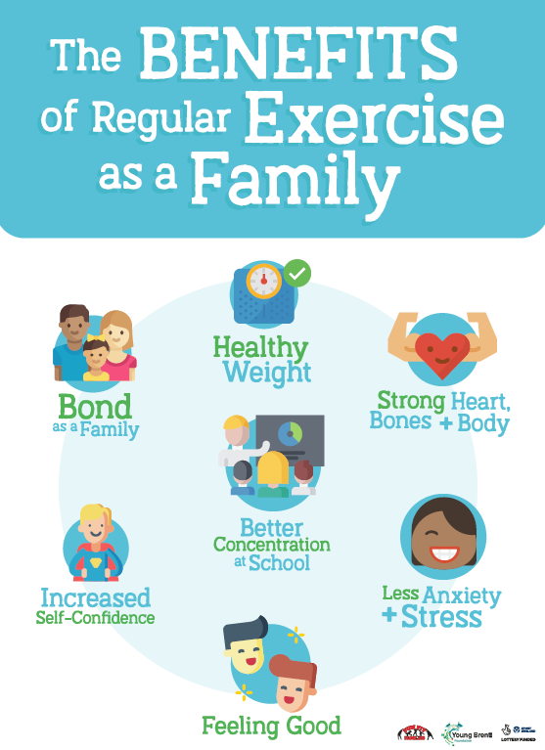
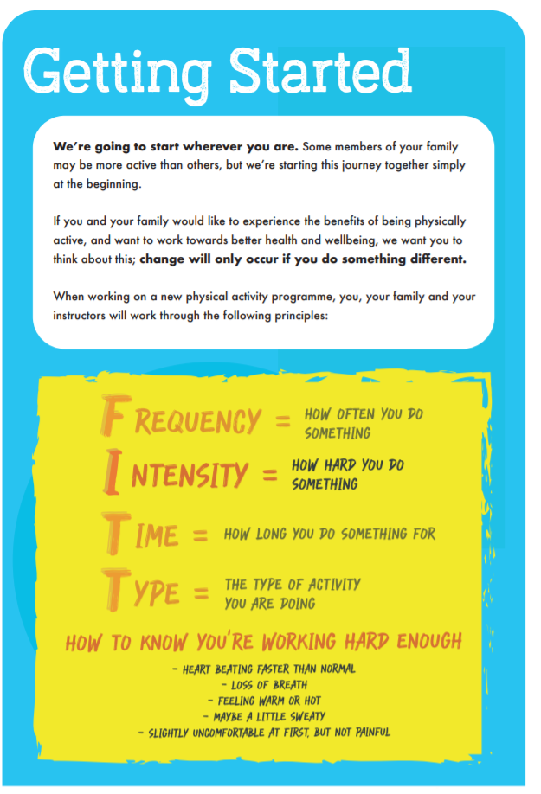
FFF Resource Booklet 12 Week Programme – Parents & Children

Slide 4
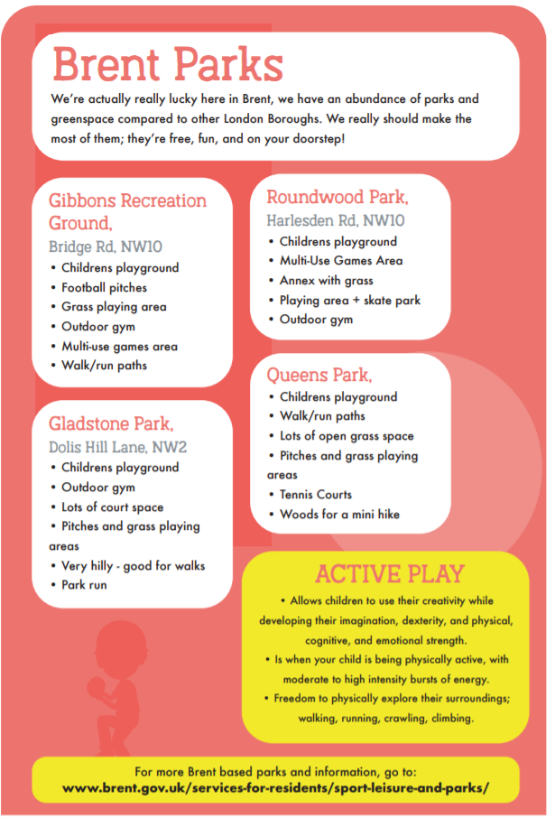
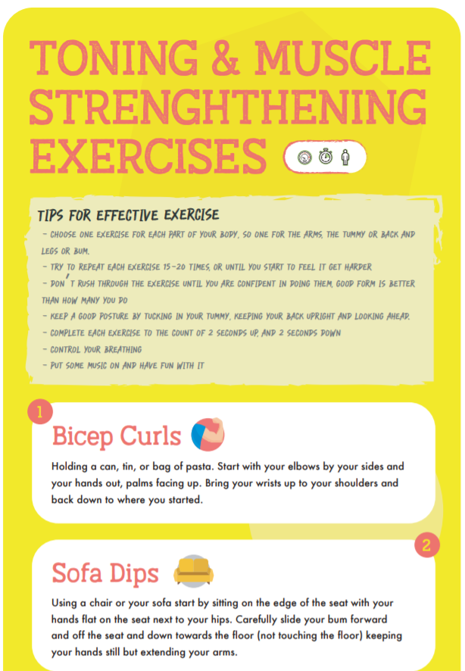

Slide 5
Progress and Rewards!

Slide 6
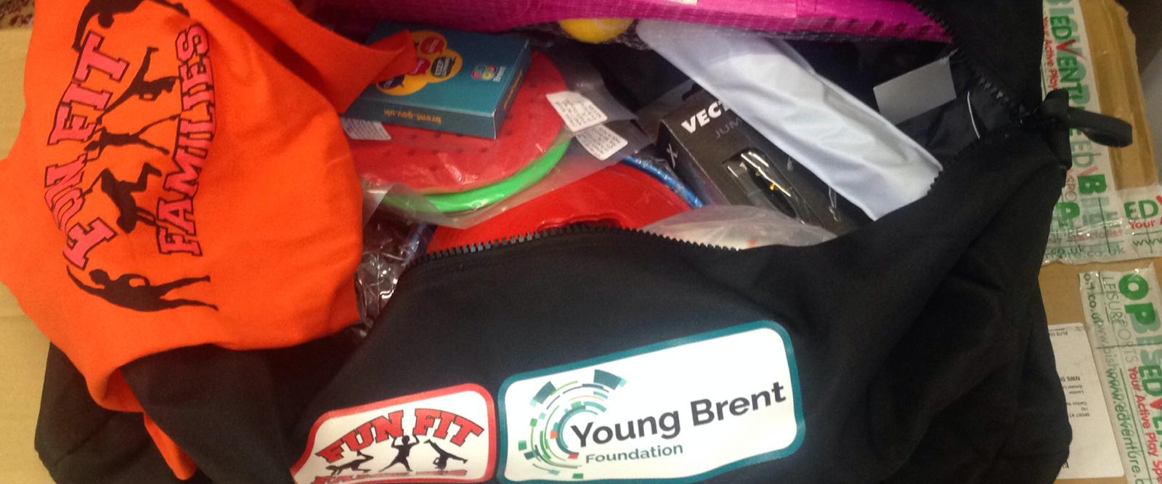
Equipment and Rewards

Slide 7
Physical Activity
FunFit Families is not a sports specific programme. It is designed to incorporate a wide variety of movement which will help families find what works best for them.
A Multi-Skills programme which aims to develop Physical Literacy
Child led with flexibility in sessions

Slide 8
Venues
 | Organisation Name | Venue | Ward
1 | Two Da Stage | Ark Academy | Barnhill
2 | Youth Engagement Solutions (YES) | Vale Farm | Sudbury
3 | Sport at The Heart | Roundwood Youth Centre | Willesden Green
4 | Hillside Performing Arts | Preston Manor School | Preston
5 | Active Sporting Communities | Capital City Academy/Malorees | Willesden Green
6 | Teth | Bridge Park Leisure Centre | Stonebridge
7 | Phenomenal CIC | Alperton Family Wellbeing Centre | Alperton
8 | Sport at The Heart | Fawood Family Wellbeing Centre | Stonebridge
9 | Sport at The Heart | Three Trees Family Wellbeing Centre | Harlesden
10 | Sport at The Heart | Church Lane Family Wellbeing Centre | Fryent
11 | Sport at The Heart | Preston Park Family Wellbeing Centre | Preston
12 | Sport at The Heart | Granville Family Wellbeing Centre | South kilburn
13 | Sport at The Heart | Granville Family Wellbeing Centre | South kilburn
14 | Sport at The Heart | St Raphs Family Wellbeing Centre | Stonebridge
15 | Active Sporting Communities | Roe Green Park, Kingsbury - possibly moving to a school | Kingsbury

Slide 9
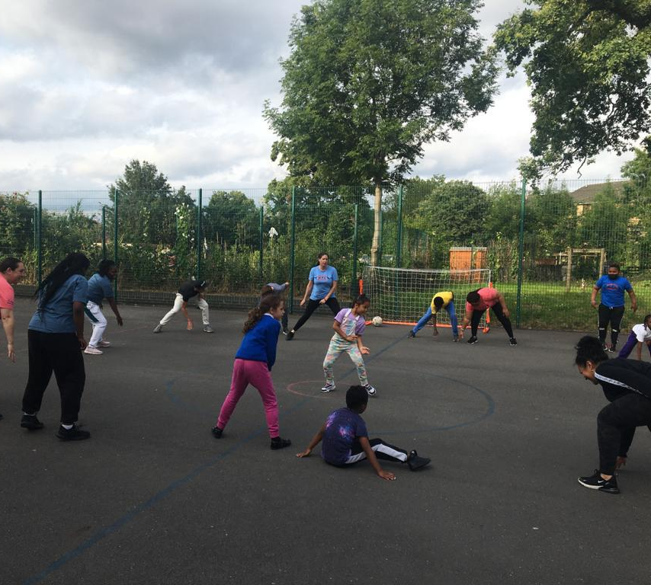
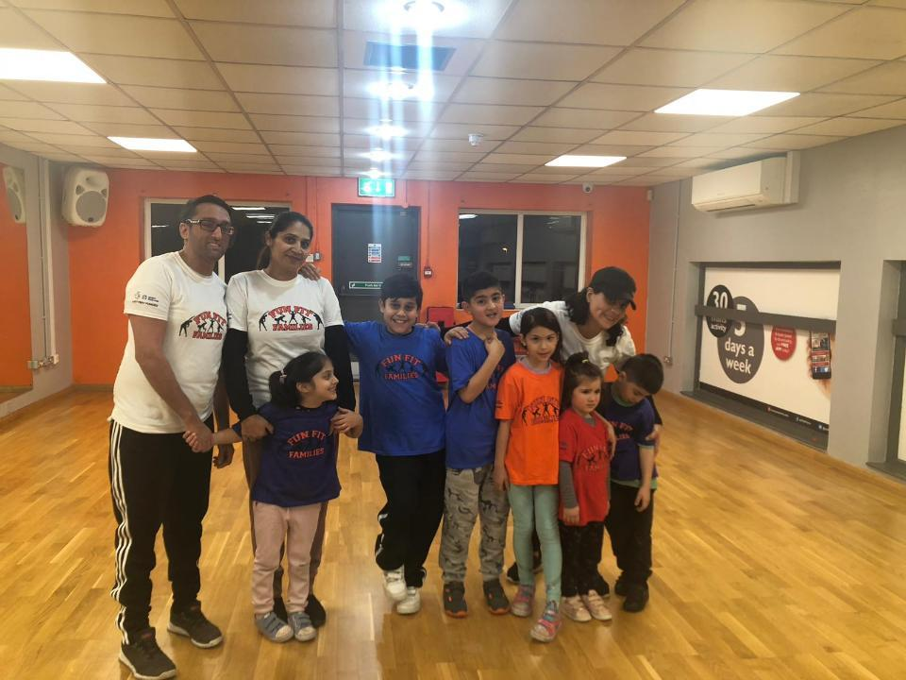
What is the data showing to date?

Slide 10
Demographics
Families: 426 engaged Individuals: 1156 Ages 5-11: 516 Ages 12-16: 80 Under 5s: 104 36% Adults
40% live in top 20% most deprived areas; 28% - 20-40% most deprived
56% of children are brought with mother (incl. stepmother)
64% Female
39% Black/Black British; 24% Asian/Asian British; 9% mixed; 19% white
Reaching the hardest to reach and least active groups

Slide 11
Activity Levels
7 and Under
58% less active at baseline; Only 13% active every day
Active – doing an average of 60 minutes or more a day​
Fairly active – doing an average of 30-59 minutes a day​
Less active – doing less than an average of 30 minutes a day
8 to 17 Years
69% less active at baseline; 12% active every day
Active Lives
Nationally 32.4% are less active; 44.6% active every day Brent 20-21 data – 29.6% less active; 41.5% active
Adults
50% adults inactive at baseline;
Active - doing at least 150 minutes a week​
Fairly active - doing 30-149 minutes a week​
Inactive - doing fewer than 30 minutes a week

Slide 12
After 12 weeks engaging with FFF
503 participant follow ups after 12 weeks on the programme
After 12 weeks, On average, how often do you do a physical activity as a family?​
Baseline Follow up 12 weeks
Never 20% 0%​
Once a month 25% 1%​
2 to 3 times a month 23% 31%​
4 times 6% 26%​
5 times or more 5% 26%​
Effect of doing physical activity as a family on Participants Family?
82% agreed or strongly agreed it brings us closer together
82% agreed or strongly agreed it increases the amount of quality time we spend together
61% agreed or strongly agreed it helped us be more open and honest when talking to one another
Do you intend to continue to be physically active as a family?
50% said definitely; 29% said yes I hope so
Activity Levels
- 82 CYP have increased their activity levels after 12 weeks
- 65 adults have increased their activity levels after 12 weeks

Slide 13
Sport and physical activity
Where are CYP getting their sport and activity?
Most common activities are: Walking to and from school and other places; PE in school, Active Play
Only 7% swimming as an activity
Only 5% Cycling as one of their activities
9% attending a sports club
After 12 weeks on the programme – CYP Attitudes to Sport/PA
75% of young people understand why sport and exercise is good for them
68% feel confident when doing exercise and sport
71% know how to get involved and improve their skills in lots of different types of exercise and sport
76% enjoy taking part in exercise and sport

Slide 14
Child Weight Management referrals
Year 1 referrals – 100% Improved their Physical Activity levels
Year 7 referrals – 75% Improved their Physical Activity levels
Verbal feedback from the families who attended has been really positive and some parents have reported that their children have lost weight.

Slide 15
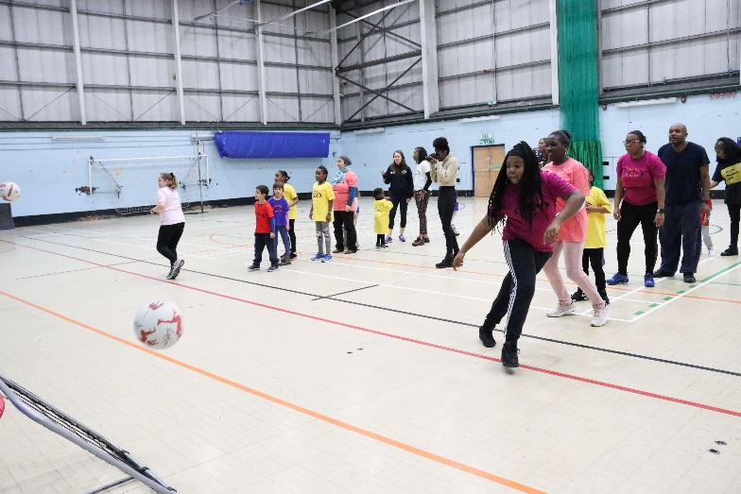
Participant’s Feedback
Member’s Feedback
Physical activities helped my daughter lose some weight and gain self-confidence. As a result, she become calmer and more approachable. Our relationship improved so much that we were able to have a mother- daughter conversation without shouting. She also made some friends who she is still in touch with.
It has been amazing to see parents and children playing together. It has been a bonding experience between parent and child. The FFF activities enable the whole group to form positive relationships.
Both parents and children report having better communications, more time together and in the words of children more fun
I have seen the children really enjoy being active with their parents, and they regularly request activities/ games that they can be in a family ‘team’. The children visibly enjoy playing with their parents as opposed to being watched or cheered on by them.
'I like to see my children having fun but I also like that I’m having fun with them'
I think parents are given the confidence and tools to steer their family towards being active. I have seen parents ask me about other opportunities for themselves and their children outside of the session
Physical activities and contact with other people helped us get rid of bad emotions, aggression and anger.

Slide 16
https://youtu.be/Evok9h8IAHA

Slide 17
Case Study – Behaviour change
I have two children son, Rafal, who is ten and thirteen years old daughter, Evelina.
We joined the Fun Fit Family project with YES in May 2019. Me and my children went through very difficult experience in life. We were scared, aggressive and lacking assertiveness and confidence.
With Fun Fit Families we were trying to start a new life.
My son Rafal did not like to do any physical activities and was reluctant to join the Fun Fit Families programme.
After attending a few sessions his attitude and behaviour started to change and he became interested in the activities and liked the contact with other children. He made new friends and became a self-confident boy liking fun games and team play activities.
My daughter Evelina lacked her confidence and was distrustful. She had difficulties to make friends.
Physical activities helped her lose some weight and gain self-confidence. As a result, she become calmer and more approachable. Our relationship improved so much that we were able to have a mother- daughter conversation without shouting. She also made some friends who she is still in touch with.
I am very grateful to YES and Fun Fit Families for giving us our family relationship back and for all you have done for us. It took three months to change our lives.
Physical activities and contact with other people helped us get rid of bad emotions, aggression and anger.

Slide 18
Case Study - Health
We are an Asian family living in Brent with my husband and two daughters 10 & 4 years old.
We were introduced to Fun Fit Family project with YES at Wembley Park Primary School that my daughters are attending to.
The school informed us that YES will deliver activities at school premises after the school hours and those are for the children as well as the parents. We did find it very attractive as we could spend some time together as well as meet other parents and my daughters could see their friends and play with them.
My daughters were very keen to join especially because their class mates were going to be there. We all joined the project at the beginning of December and like it since.
My personal benefit for the project is that I have been diagnosed with diabetics and was advised to do more exercises for my health benefit. Therefore, it was a great opportunity for me to keep active and at the same time enjoy myself and meet other parents.
When the pandemic started, and we all went to lock down I was concerned for myself and my family about keeping active and healthy.
I was very pleased to discover that YES was providing sessions online and we could keep being active at home.
It keeps my family happy and active. Despite the lock down we are still doing our activities, following the exercises online and also doing some dancing at home with my girls and going daily for a walk.
It helped me and my family to keep active, happy and healthy.

