Slide 2
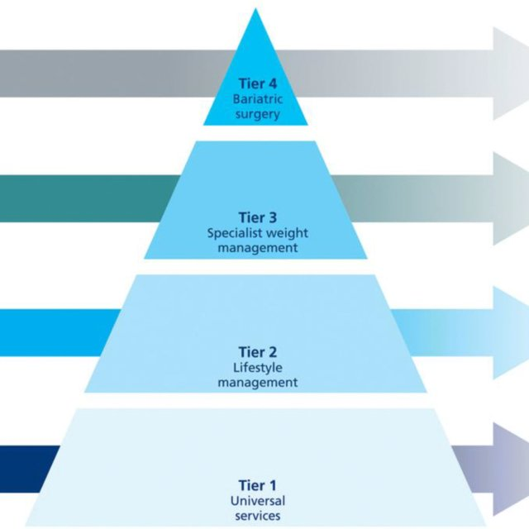
Welcome!
Our programmes have been running for 15 years and are designed to suit different groups with different needs
Tier 2 weight management services commissioned by Brent Council on behalf of OHID
1 in 3 children obese in Brent. 70% adults obese/overweight in Brent.
Combatting rising rates of obesity and overweight in children and adults
Diversity and Inclusion!

Slide 3
BeeZee Children & Family Programmes
Eligibility for 5-15 yr olds:
Have a child with a BMI above the 91st centile
Live/go to school/be registered with a GP in Brent

Slide 4
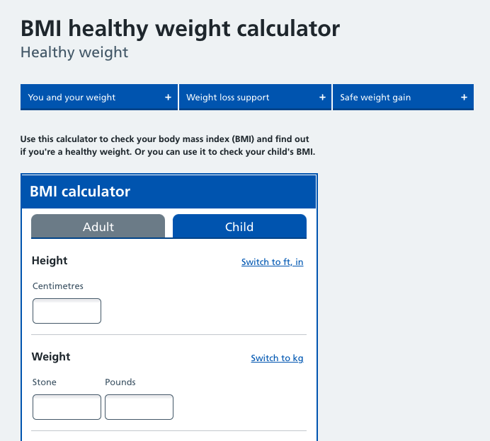
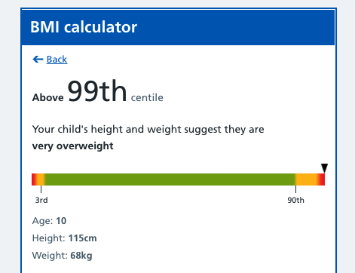
Is the child eligible?
https://www.nhs.uk/live-well/healthy-weight/bmi-calculator/
Notes:
To check a child’s eligibility or even adult’s too we use the NHS BMI calculator. This takes your height, weight, age, ethnicity and activity level and gives you a centile score. A score above the 91st centile suggests a child is overweight for their height and age.

Slide 5
Our Programmes

Slide 6
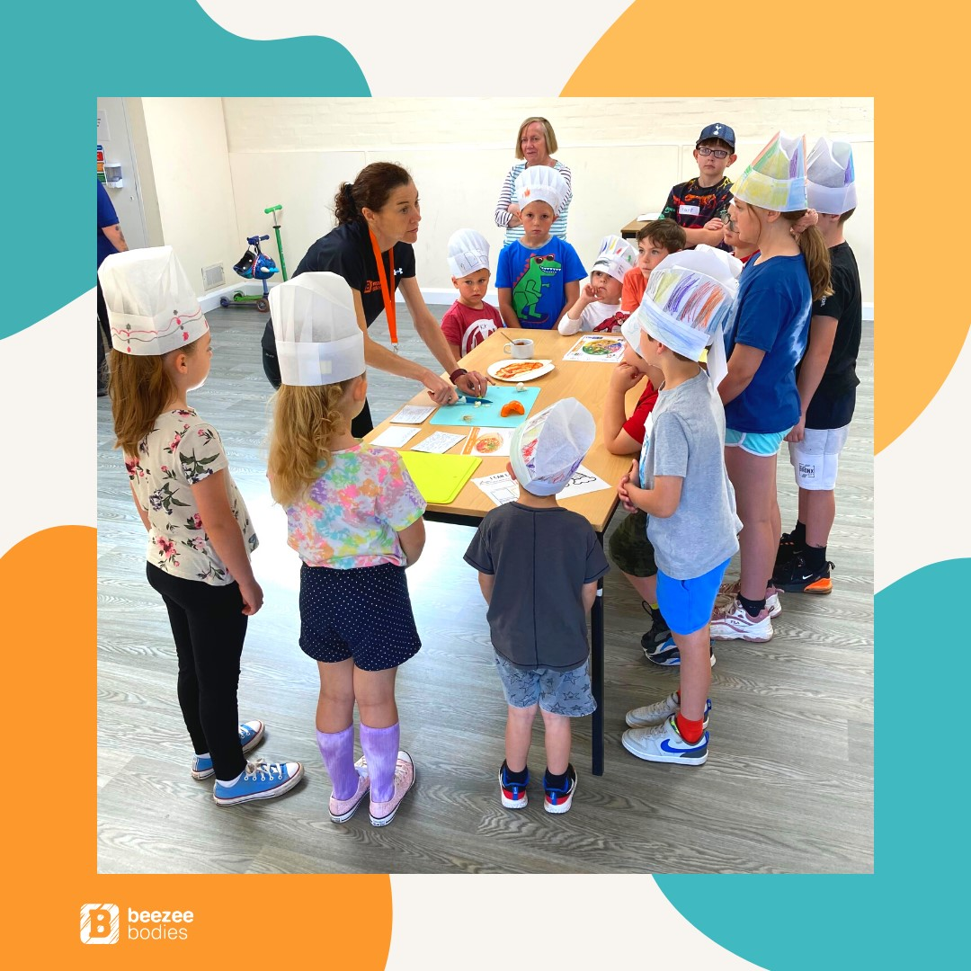
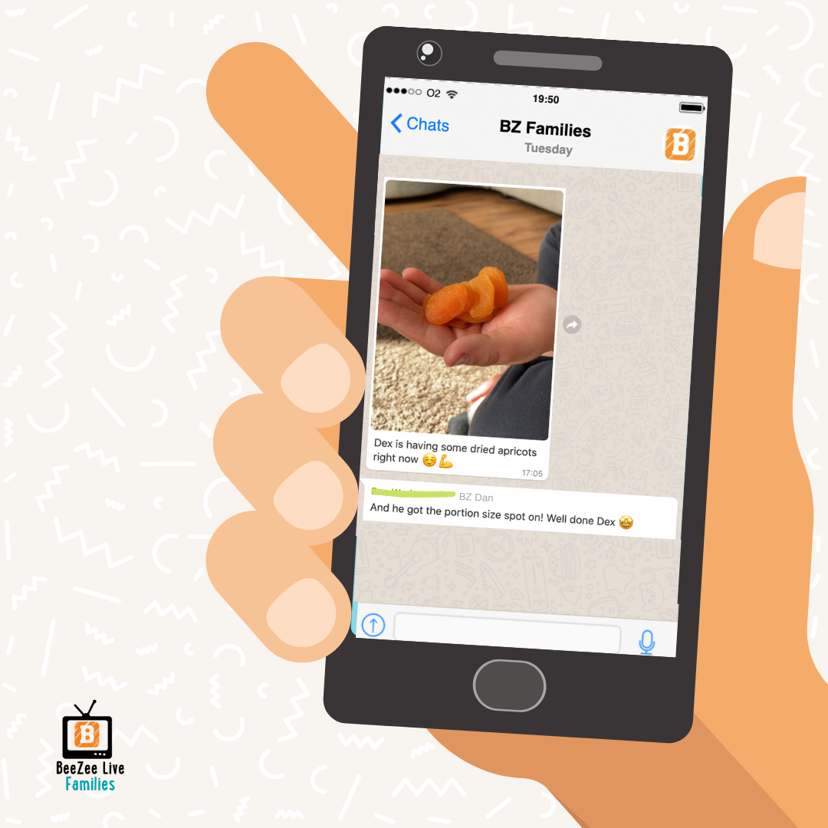
BeeZee Families
12-week, in-person programme aimed at children (aged 5-15 years) and their families
Each week involves a 2-hour session:
1st Hour practical healthy eating advice delivered by our qualified nutritionists
2nd Hour physical activity delivered by a qualified sports coaches
Topics include; portions sizes, breakfast, reading food labels and more!
Programmes created using evidence-based nutrition and behavioural change science (habit before the habit & COM-B)
Support for parents during and outside of sessions
WhatsApp, Experiments
Mid-way reviews and Graduation

Slide 7
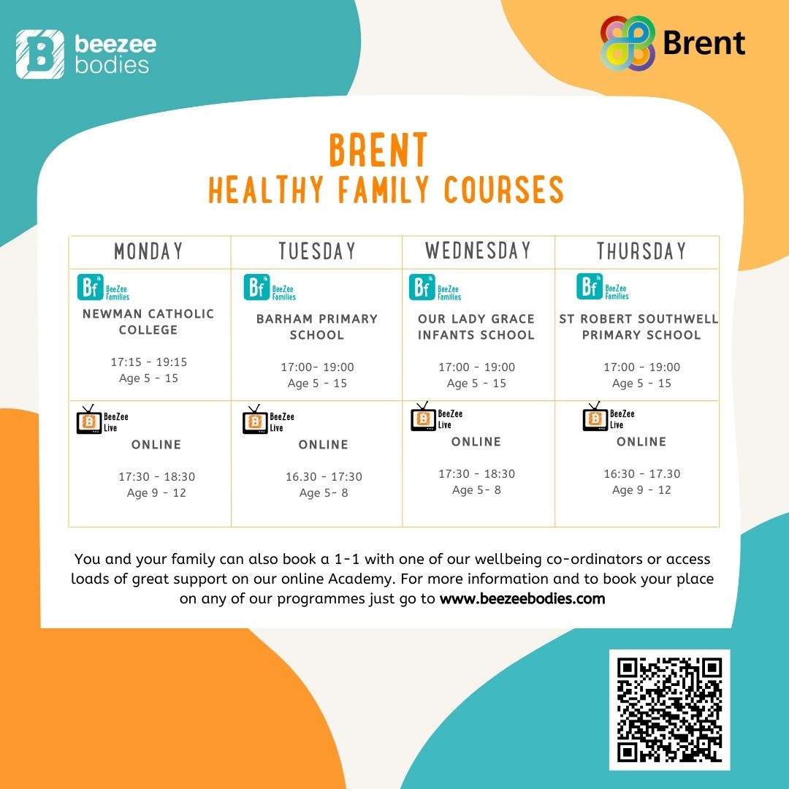
Brent Timetable February 2022
Notes:
We will re-run sessions for the full 12 weeks again

Slide 8
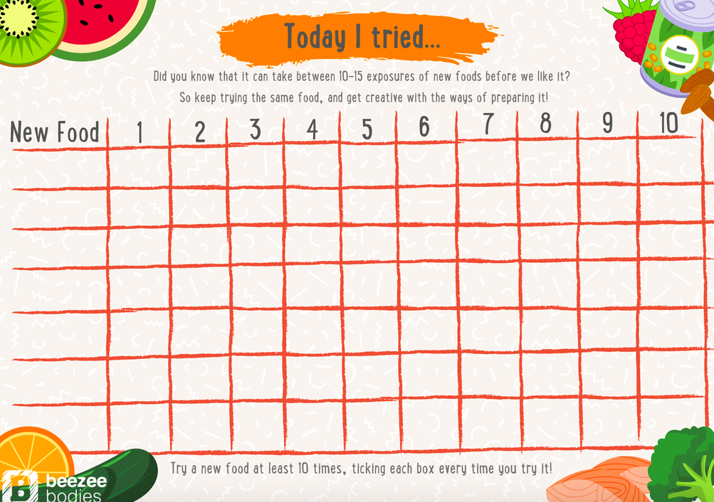
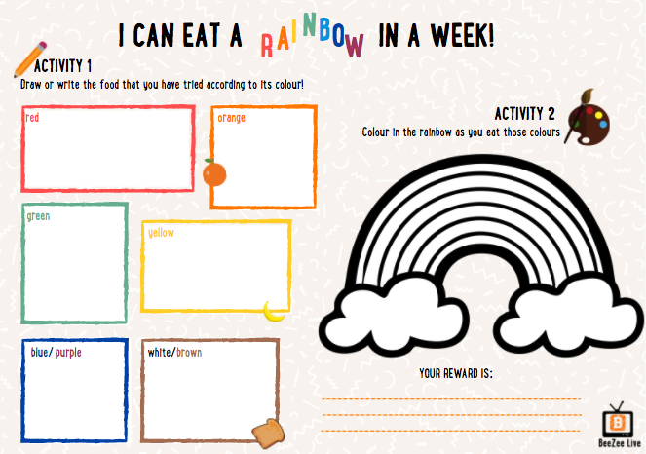
BeeZee Families Examples

Slide 9
BeeZee Live
12-week online programme aimed at children (aged 5-15 years) and their families
Each week is a 1 ¼ hour session
Includes practical healthy eating advice from our qualified nutritionists
Topics include; portions sizes, breakfast, reading food labels
Programmes are created using evidence-based nutrition and behaviour change science
Outside the weekly webinars, the BZ team will support families via WhatsApp and Google classroom

Slide 10
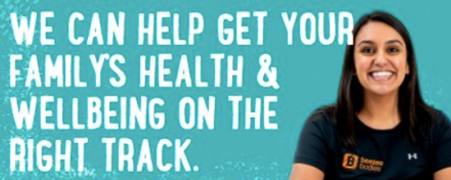
BeeZee Lite
1 Hour consultation with a Wellbeing Co-ordinator
Informal and non-judgmental
Advice tailored to the family
Detailed action plan to take away
Check-in appointment 1 month later
Eligibility still applies
52% of families go onto the in-person BeeZee programmes

Slide 11
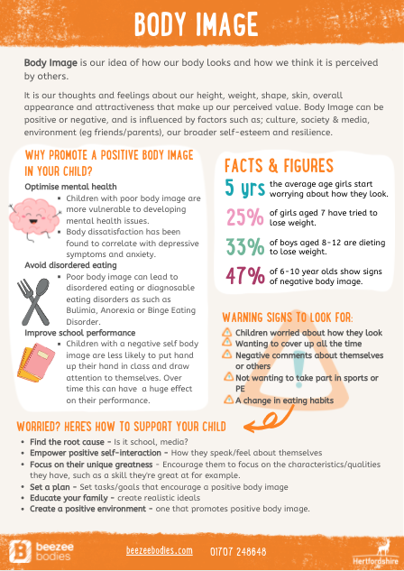
BZ Academy
An online portal full of healthy living resources to help young people and parents/carers to learn about diet
No calls, meetings or appointments – log in and learn during your own time
Initial questions to give you recommended posts and courses
Includes recipes, parenting blogs, fussy eating, sleep, how to talk about weight and tips for all the family

Slide 12
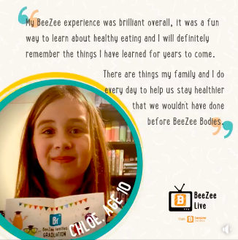
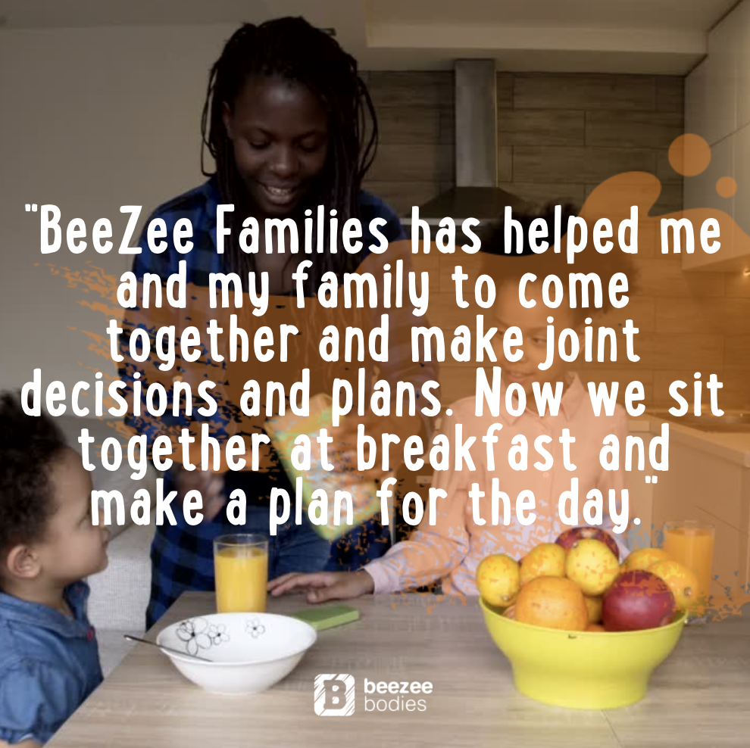
Don’t take our word for it… take theirs

Slide 13
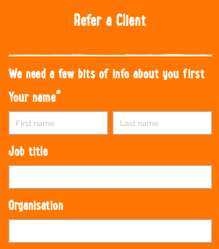
How a family refers/ you refer a family?
What we need to know:
Child’s name
Child’s DOB
Child’s home address
Parent's name and contact details
Parent’s consent
Your name and contact details
Call the BeeZee Bodies Team on 03308 186 308
Email us at beezee.bodies@nhs.net
Log onto beezeebodies.com and fill out our online form
Notes:
The orange box will change depending on whether you are the referrer or the family directly refers themselves but the details are more or less the same. They will also ask how you heard of our services and you can either put my name down or there should also be an option for email recruitment.

Slide 14
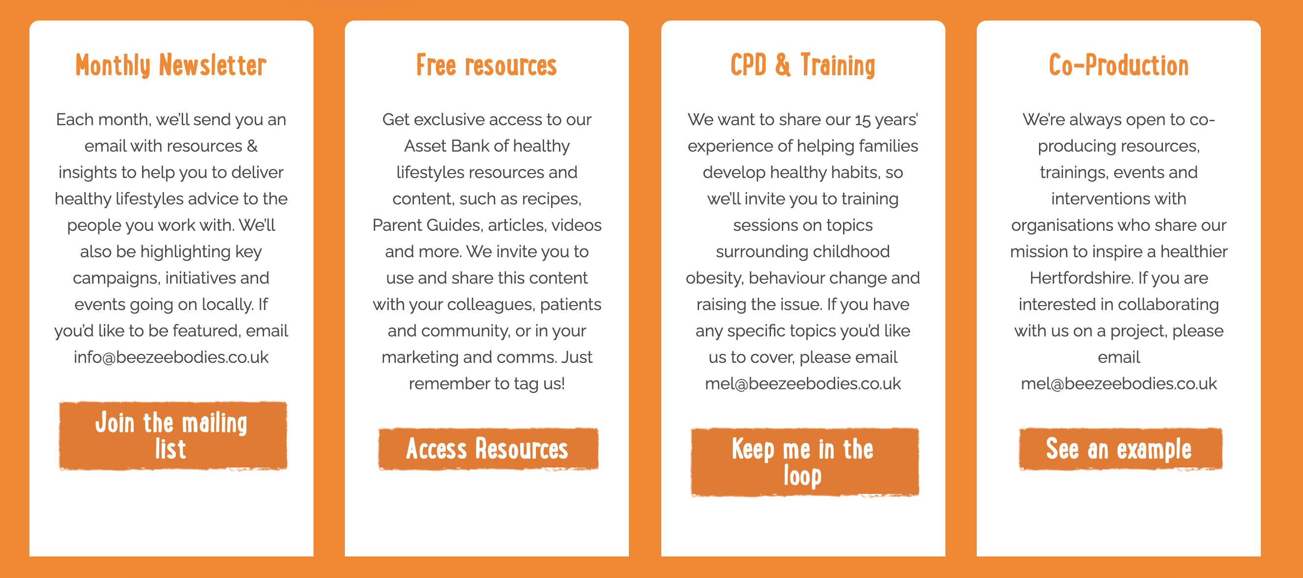
Partnerships and Resources

Slide 15
Any Questions?

