Slide 1
You Decide: Participatory Budgeting

Slide 2
Agenda
Introduction to You Decide
What is Participatory Budgeting
Key stages of Participatory Budgeting
You Decide Carbon Offset Fund (CO₂GO)
Key milestones
You Decide Neighbourhood Community Infrastructure Levy (NCIL)
Together Towards Zero
Q&A

Slide 3
Introduction to You Decide
You Decide is the Brent name for both Participatory Budgeting (PB) initiatives
PB is a proven model of local decision making
Local people vote for the best community projects in their area
Two programmes will be delivered over the next 12 months:
You Decide CO₂GO
You Decide NCIL

Slide 4
What is Participatory Budgeting?
An international method of enabling local people to make decisions on how one or more public sector budget is spent
Local people come together and decide how this money will benefit their community
Applications are submitted by local organisations
Local people attend ‘Decision Day’ presentations (in person or by film) of the local applications
Residents then vote on the project ideas submitted

Slide 5
Key stages of PB
Phase One | Phase Two | Phase 3
Provide information through a strong communications and engagement plan Face to Face Engagement with local stakeholders Proactive community engagement activities | You Decide open to receive Applications – online, email and paper versions can be posted Support programme with 1-2-1 surgeries, drop-in events and evening meetings Active community engagement to attract applications from diverse communities Application closes – Grants Team check eligibility before projects proceed to next phase | Residents invited to participate in ‘Decision Day’ events – local project ideas presented to the whole community. Voting takes place to select the projects residents want delivered.
CO₂GO | Applications opened 21 October 2021 and closed 8 January 2022 | 29 January 2022 – 1 borough wide event – distribution of £500k across 2 pots
NCIL is in Phase one now | May 2022 – July 2022 | July 2022

Slide 6
You Decide – Carbon Offset Fund
Carbon Offset Fund allows progress against the Climate Emergency and Biodiversity Strategy
Making homes more carbon efficient can reduce fuel costs and improve fuel poverty
CO₂GO was designed with fuel poverty in mind – aiming to attract applications from all people across the borough
Criteria have been set by local residents from all Brent Connect areas – diverse group from different backgrounds and ages
This was a Borough wide application process

Slide 7
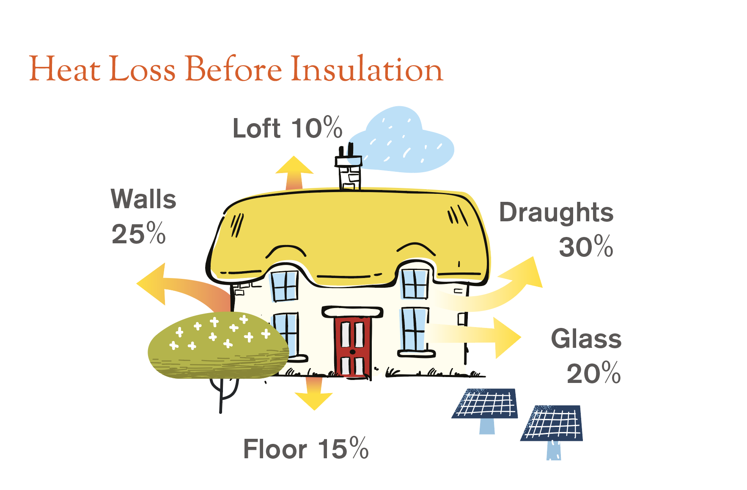
Pot 1 - £400,000
You can apply to make carbon-reducing
adaptations to the building you live in
Join with others in your street or
building to apply as a cluster of
connected homes
A ‘cluster’ is a minimum of three
homes with a physical connection, e.g.
a terrace or flats in the same building
Apply for up to £10,000 per home
Community buildings can also apply
Reduce carbon emissions from homes & buildings, and make homes cheaper to run.
Heat loss without insulation

Slide 8
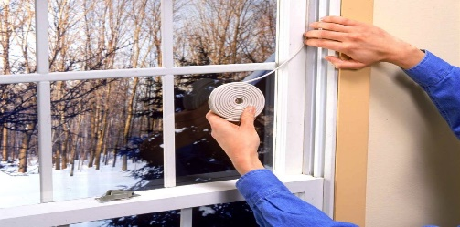
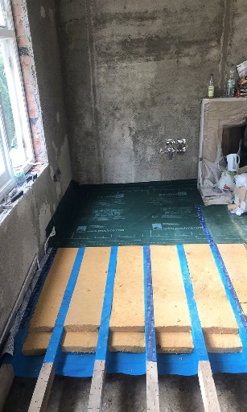
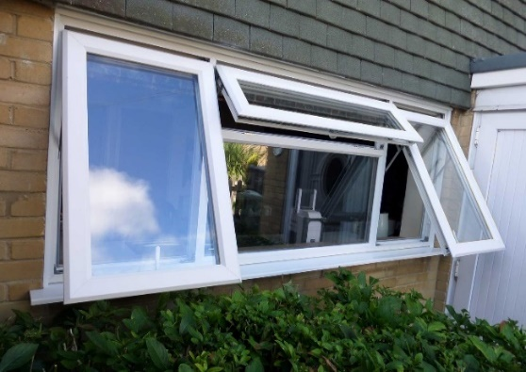
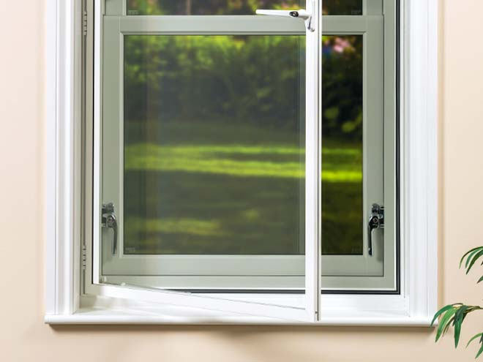
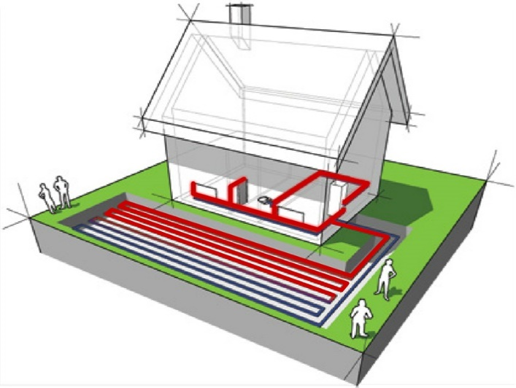
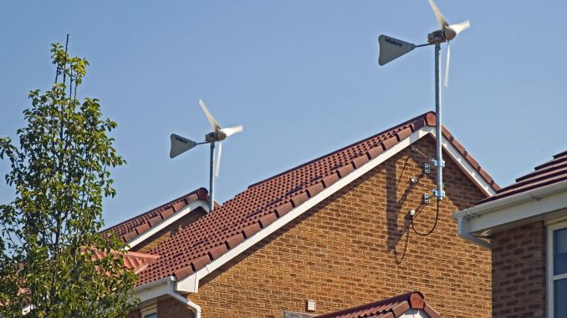
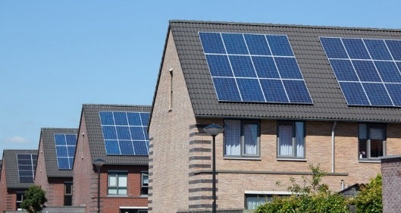
C02GO – Pot 1 possible ideas
Draft exclusion around doors and windows,
and under doors
Secondary glazing for windows
Insulate under floor boards
New double glazed doors and windows
Roof wind turbines
Solar panels on the roof
Ground-source
heat pump under a garden
Double glazing Solar panels
Secondary glazing
Draft excluding – doors, windows, old floorboards, loft hatches
Roof wind turbines

Slide 9
POT 2: £100,000 Education and Awareness to Reduce the Carbon Footprint in Brent
Bidders were able apply for between £500 and £20,000 for each project
Bidders can be from constituted organisations or from collectives of residents. Individuals could not apply
Bidders must be 18 years or older. Groups of young people can create a proposal but the person who signs the forms and takes responsibility for delivery must be over 18
Bidders can be from outside of Brent as long as all projects and ideas benefit Brent residents

Slide 10
Timeline – Key Dates for your diary
Applications open – 21 October 2021
Application Support Sessions
Tuesday 9th November 2021 6-7 pm
Tuesday 23rd November 2021 7-8 pm
Tuesday 7th December 2021 6-7 pm
www.brent.gov.uk/climateemergency/carbonoffset
Presentation Support Sessions
Wednesday 12 January 2022 AM
Wednesday 12 January 2022 PM
Saturday 15 January 2022 Midday
Application deadline – Saturday 8 January 2022
Decision day event: when you vote!
Pot 1 – Saturday 29 January 2022, morning
Pot 2 – Saturday 29 January 2022, afternoon

Slide 11
You Decide NCIL
You Decide NCIL will focus on physical improvement projects
Physical improvement projects include:
a new community garden
renovations to a local community centre
a new sports pitch
new pieces of street art to improve the local area
new equipment and furniture to help a children’s centre
Each Brent Connects area will decide on £400k (£2m total this round)
Five online ‘Decision Day’ events will take place – one in each Brent Connects area
Opens summer 2022, but it’s time to talk and think ahead of this

Slide 12
Criteria
In order to apply for this Grant Fund, your idea must:
meets at least one strategic objective
have evidence of community support
demonstrates support from Ward Councillors
meets local priorities
a physical improvement project
be a one off idea that will not incur further costs to the council
impacts positively on different groups in Brent
is value for money

Slide 13
What to expect ahead of the Decision Days later in 2022? (example question from 29.01.22)

Slide 14
Do you want to be part of the next resident-led panel group?
Send an email to youdecide@brent.gov.uk with your details to get involved and stay in touch about the next participatory budgeting programme

Slide 15
New Eco Grant - Together Towards Zero - £50,000
There is £50,000 available for projects and initiatives to be delivered across Brent to complement the Carbon Offset Fund.
You can apply to deliver a one-off environmental project or initiative within Brent that improve local areas by making them greener, cleaner and more environmentally friendly.
Encouraging local residents to apply, there are many great ideas that can support the local community – We want to hear from you!
Community groups, faith groups, organisations, local businesses and constituted and un-constituted groups are all welcome to apply.
Apply for up to £1,000
Notes:
Brent Council declared a Climate and Ecological Emergency in July 2019, pledging to do all in its gift to achieve carbon neutrality in the borough by 2030.
Climate and Ecological Emergency Strategy (2021-2030) focuses on five key themes.
One of the five key themes within the Strategy is ‘Supporting Communities’ with the overarching objective of ensuring that everyone who lives, works or studies in Brent will have improved access to clear and understandable information on the need to tackle the climate and ecological emergency.
One of the 23 actions relating to the ‘Supporting Communities’ theme is to launch a small grants programme for green community projects, to complement the Brent Carbon Offset Fund focused on carbon reduction in homes and buildings. The council has secured £50,000 to support local community projects.

Slide 16
Criteria
In order to apply for this Grant Fund, your project or initiative must:
The Application is within the £1000 maximum amount
The applicant meets the eligible individual, business or organisation status;
The Project will be based in Brent;
Support any of the objectives of the five themes within the council’s climate and ecological emergency;
Make Brent’s local environment greener and more biodiverse; or offer an opportunity for a tangible carbon saving in a community setting;
Reach into the community, allowing as many local residents to participate or benefit from the project as possible;
Be clearly deliverable;
Leave a positive environmental impact.

Slide 17
Criteria
You must choose at least one of the five key themes and objectives of Brent Council’s climate and ecological emergency
Theme 1 Consumption, Resources and Waste | Theme 2 Transport | Theme 3 Homes, Buildings and the Built Environment | Theme 4 Nature and Green Space | Theme 5 Supporting Communities
By 2030, our communities will be living more sustainably: consuming less of the products and materials that accelerate climate change, whilst also wasting less of the world’s natural resources. This behaviour shift will have helped to cut Brent’s consumption emissions by two-thirds, and drive a substantive reduction of household waste produced within the borough. | By 2030, petrol and diesel road journeys will have at least halved in the borough, being driven as close as possible to zero, with an accompanying increase in journeys made by residents through cycling, walking or public transport. | By 2030, as many homes and buildings in the borough as possible will be more energy efficient, be powered by renewable sources and be resilient to future adverse weather events caused by climate change – and we will do all in our gift to achieve an average rating of Energy Performance Certificate B in directly owned council stock. | By 2030, Brent will be one of the greenest, most biodiverse and climate-resilient boroughs in London with our residents better connected to nature. | Everyone who lives, works or studies in Brent will have improved access to clear and understandable information on the need to tackle the climate and ecological emergency, and as many people as possible will be actively engaged in taking action to help the borough become carbon neutral by 2030.

Slide 18
Together Towards Zero – projects & initiatives up to £1,000
These are examples of schemes, but ideas are not limited to this list.
Applicants are encouraged to think as creatively and innovatively as possible:
Re-use and repair projects
Local recycling / waste reduction initiatives
Community gardens
Community orchards / tree nurseries
Environmental education programmes or resources
Community environmental challenges
Notes:
Brent Council declared a Climate and Ecological Emergency in July 2019, pledging to do all in its gift to achieve carbon neutrality in the borough by 2030.
Climate and Ecological Emergency Strategy (2021-2030) focuses on five key themes.
One of the five key themes within the Strategy is ‘Supporting Communities’ with the overarching objective of ensuring that everyone who lives, works or studies in Brent will have improved access to clear and understandable information on the need to tackle the climate and ecological emergency.
One of the 23 actions relating to the ‘Supporting Communities’ theme is to launch a small grants programme for green community projects, to complement the Brent Carbon Offset Fund focused on carbon reduction in homes and buildings. The council has secured £50,000 to support local community projects.

Slide 19
Together Towards Zero – Next steps Plan and submit your project ideas!
Contact us to receive a paper application pack or go online at: Brent Council - Climate emergency (includes application form, guidance note, FAQs, Safeguarding and Data Protection pack* included for projects that are working with children, young people or vulnerable adults*)
Get evidence of community support
Complete your application form and include supporting documents
Send completed form to: ecogrants@brent.gov.uk or upload via Brent Council website.

Slide 20
How can you help?
Share the website links and speak to people
Distribute leaflets – electronic or paper
Follow us on twitter – share our messages @Brent_Council
Invite us to your local meetings
Encourage ideas in the community
Talk to people
Bring local people to the ‘Decision Day’ events later in the year

Slide 21
Any questions? ecogrants@brent.gov.uk

Slide 22
Any questions? youdecide@brent.gov.uk

